Slide 1
EDA
Easy?
Difficult?
ACTUALLY MANAGABLE?

Slide 2
EDA Steps
Understand data
Create a Subset
Explore hypothesis

Slide 3
EDA Learning Curve: Issues with data
More variables = harder to do
Grouping of ages
Uneven sample size
Data already summarized
Dashes as missing data points

Slide 4
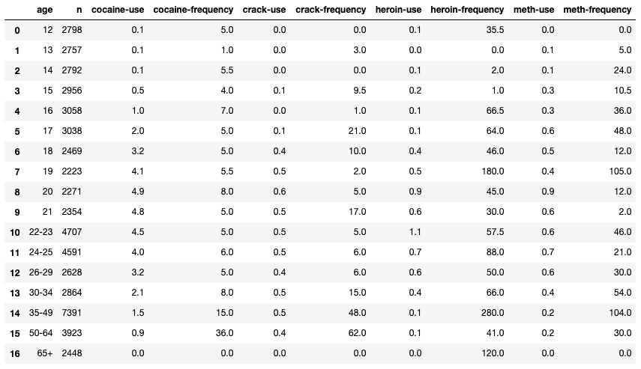
Creating a subset
Use of regular expression
Concatenation to add in age/n
Removal of age 65+ age bracket

Slide 5
Hypothesis Testing
Corr = 0.84 Corr = 0.9 Corr = 0.89
χ² = 27.89 χ² = 26.24 χ² = 25.47
H0: There is no relationship between cocaine use and other class A drugs
HA: There is a relationship between cocaine use and other class A drugs
Use of chi squared goodness of fit test
Degrees of freedom is 15 so:
alpha = .01, critical value = 30.578
alpha = .05, critical value = 24.996
* HA Accepted with Confidence = 95%

Slide 6
QUESTIONS?

